Slide 1
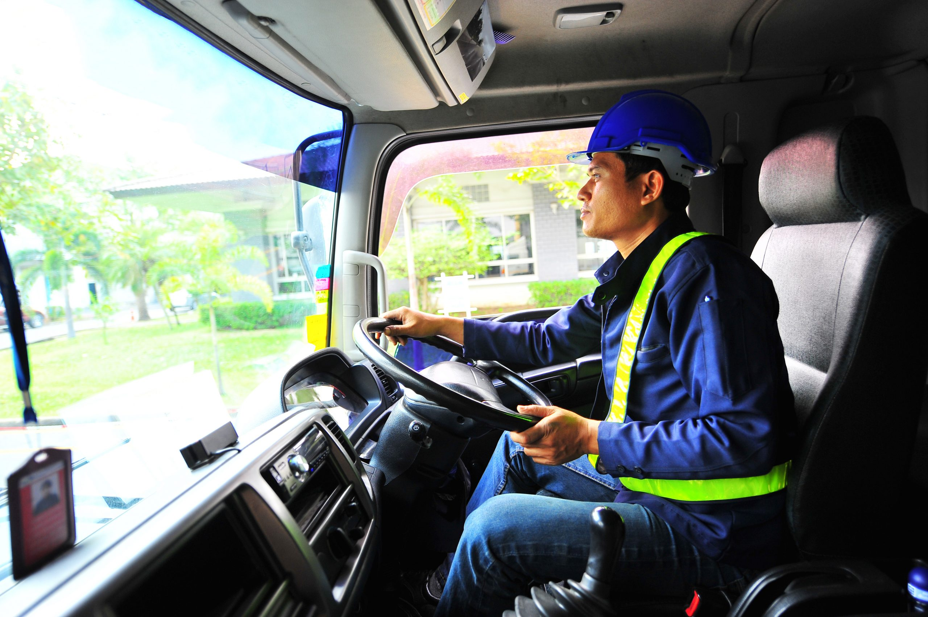
Project Akanksha: Tata Motors' Flagship Skilling Program PRESENTED BY PrANAV VALVI

Slide 2
What is Project Akanksha ?
Project Akanksha is a CSR initiative by Tata Motors that aims to provide skill development training to commercial vehicle drivers in India. The program was launched in 2010 and has since trained over 50,000 drivers.
The goals of Project Akanksha are to: Improve the driving skills of commercial vehicle drivers, Enhance their knowledge of road safety, Make them more employable, and Target audience.
The target audience for Project Akanksha is commercial vehicle drivers in India. The program is open to drivers of all ages and experience levels. Partnerships.

Slide 3
Program overview Curriculum
The Project Akanksha curriculum covers a wide range of topics, including:
Driving skills, Road safety, Vehicle maintenance, First aid, Soft skills, and Training methodology.
The training methodology used in Project Akanksha is a combination of classroom instruction, practical training, and simulation exercises. Assessment and certification.
Participants in Project Akanksha are assessed on their driving skills, knowledge of road safety, and vehicle maintenance. Those who successfully complete the program are awarded a certificate from Tata Motors.

Slide 4
Impact Number of drivers trained
Project Akanksha has trained over 50,000 commercial vehicle drivers in India since its launch in 2010. Feedback from participants.
Participants in Project Akanksha have given positive feedback about the program. They have said that the training has helped them to improve their driving skills, knowledge of road safety, and employability. Success stories.
There are many success stories of Project Akanksha participants. For example, one participant was able to get a job as a driver for a multinational company after completing the program. Another participant was able to start his own transport business.

Slide 5
Future plans Expansion of the program
Tata Motors plans to expand Project Akanksha to train more commercial vehicle drivers in India. The company also plans to introduce new training modules on emerging technologies such as electric vehicles. New partnerships.
Tata Motors is looking to partner with new government agencies, NGOs, and industry associations to implement Project Akanksha. Additional training modules.
Tata Motors plans to introduce new training modules on emerging technologies such as electric vehicles.

Slide 6
Conclusion Summary of the program
Project Akanksha is a CSR initiative by Tata Motors that aims to provide skill development training to commercial vehicle drivers in India. The program has trained over 50,000 drivers since its launch in 2010.
Tata Motors is committed to empowering commercial vehicle drivers in India. The company encourages all eligible drivers to participate in Project Akanksha.

